Slide 1
Leadership & Teams
Key Points from Chapters 12 & 13
1 | 2 | 3 | 4 | 5 | 6 | 7 | 8 | 9 | 10 | 11 | 12 | 13 | 14 | 15 | 16 | 17 | 18 | 19 | 20
21 | 22 | 23 | 24 | 25 | 26 | 27 | 28 | 29 | 30 | 31 | 32 | 33 | 34 | 35 | 36 | 37 | 38 | 39 | 40
41 | 42 | 43 | 44 | 45 | 46 | 47 | 48 | 49 | 50 | 51 | 52 | 53 | 54 | 55 | 56 | 57 | 58 | 59 | 60
61 | 62 | 63 | 64 | 65 | 66 | 67 | 68 | 69 | 70 | 71 | 72 | 73 | 74 | 75 | 76 | 77 | 78 | 79 | 80

Slide 2
Overview
Foundational Concepts in Leadership
Theories of Leadership
Teams: Basic Definitions
Team Processes

Slide 3
Foundational Concepts in Leadership

Slide 4
Popular Ideas about Leaders
“Leaders aren't born, they are made. And they are made just like anything else, through hard work. And that's the price we'll have to pay to achieve that goal, or any goal.”
“Leadership rests not only upon ability, not only upon capacity; having the capacity to lead is not enough. The leader must be willing to use it. His leadership is then based on truth and character. There must be truth in the purpose and will power in the character.
-Vince Lombardi

Slide 5
Popular Ideas about Leaders
“Some are born great, some achieve greatness and some have greatness thrust upon them.”
-Shakespeare
“The reasonable man adapts himself to the world. The unreasonable one persists in trying to adapt the world to himself. Therefore all progress in the world depends on the unreasonable man.” -George Bernard Shaw

Slide 6
Popular Ideas about Leaders
“Leadership is a combination of strategy and character. If you must be without one, be without the strategy.” -Norman Schwarzkopf
“You do not lead by hitting people over the head — that's assault, not leadership.” -Dwight D. Eisenhower

Slide 7
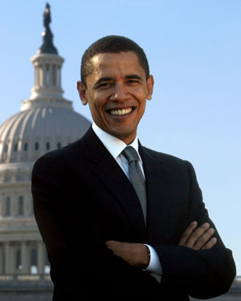
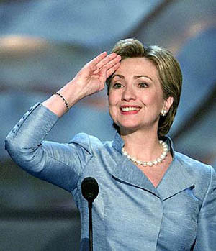
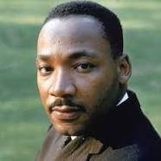
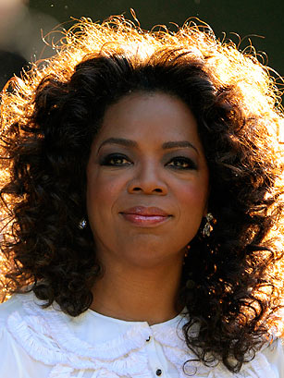
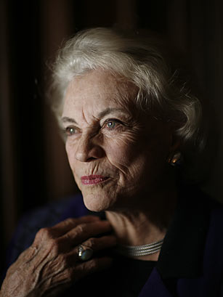
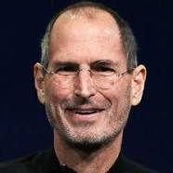

Slide 8
Leadership is…
Influence, persuasion, and inspiration.
Which affects follower attitudes, feelings, beliefs, behaviors.
The results of good leadership is enhanced follower motivation to pursue and achieve shared goals.

Slide 9
Leadership Process
Attempted Leadership
Effort
Emergence
Successful Leadership
Compliance
Effective Leadership
Goal Accomplishment
Person x Situation

Slide 10
Leaders, followers, and situation
Personality
Position
Situation
Personality, Position,
Situation
THE LEADER
THE
FOLLOWER
Relationship
THE SITUATION
Organizational culture, goals; the job itself

Slide 11
Theories of Leadership

Slide 12
Theoretical Approaches
Great Man / Great Woman
Oldest approach to leadership- began in the 1800s with great man theories

Slide 13
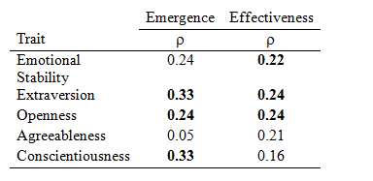
Trait Approach
How are leaders different than non-leaders?
Good leaders: Intelligence, Task Relevant Knowledge, Dominance, Self-confidence, Energy, Tolerance for stress, Integrity and honesty, Emotional Maturity, etc.
What traits predict emergence and effectiveness?
(Judge et al)
Main Problem: ignores process of leadership and followers

Slide 14
The Behavioral Approach
Ohio State Studies – focused on kinds of behavior engaged in by people in leadership roles
University of Michigan Studies – focused more on dynamics of how leaders & groups interacted
Both identified 2 major types of behavior
Consideration/Relations-oriented – behavior indicating mutual trust, respect, and certain warmth and rapport between supervisor and group
Initiating structure/Task-oriented – behavior in which supervisor organizes and defines group activities in relation to the group

Slide 15
Situational (contingency approach)
What behaviors or traits are effective in which situations?
Main Problem: no generalization of effective leadership behaviors across settings, too extreme

Slide 16
Power and Influence Approach
Leadership as an influence process
French & Raven’s Bases of Power
Coercive
Reward
Legitimate
Expert
Charismatic/referent

Slide 17
Leader-Member Exchange (LMX) Theory
Leaders adopt different behaviors with individual subordinates
In-group members vs. out-group members
Recent revisions describe “life-cycle” of a leader-follower relationship
Task of a leader is to drive relationship from tentative first-stage to a deeper more meaningful relationship
Stuck in 1st phase = out-group
Deeper phase = in-group

Slide 18
Transformational Leadership
Four Behavioral Dimensions
Idealized influence (charisma)
Role model
I want to be like you – I trust you – you are straight with me.
Inspirational motivation
Vision. Excitement, enthusiasm. We make a difference.
The work matters. There is purpose to our work.
Intellectual stimulation
Try new things, have ideas, creativity.
Make it safe to have ideas, take risks, make mistakes.
Individualized consideration
Attending to individual needs of employees.
Growth and development.

Slide 19
Newer Leadership Theories
Authentic leadership
Self-leadership
Servant leadership
Ethical leadership

Slide 20
Teams: Basic Definitions

Slide 21
Teams in the Workplace
72% of Fortune 1000 use teams
More team emphasis in the near future
Why?
Work can be performed concurrently rather than sequentially – faster!
Advances in IT
“Worker empowerment”
Innovation & creativity promoted
Keeping up with the Joneses

Slide 22
Work Groups & Teams
Group:
Member interaction
Work to achieve certain goals or meet certain needs
Formal or informal work group
Team:
High level of interaction
Work intensively together toward common goal.
Formal work group
Group
Team

Slide 23
Types of Teams
Project Teams
Created to solve specific problem, then disbanded
Challenge: Can create multiple reporting relationships
Production Teams
Front-line employees who produce tangible output
Autonomous work group: type of production team with control over a variety of functions
Virtual Teams
Composed of widely dispersed members who are linked through technology
Advantages – saves time & travel expenses, increased access to experts, expands labor market
Cultural diversity is an advantage and challenge
Trust is a critical concern. Must be increased through virtual socialization, collaboration behaviors, and communication skills

Slide 24
Team Processes

Slide 25
A Model of Team Effectiveness
Process
Norms
Communication
Coordination
Cohesion
Decision making
Input
Org. context
Task characteristics
Team Composition
Output
Productivity/Performance
Member Satisfaction
Innovation

Slide 26
Organizational & Task Inputs
Organizational context
Provide necessary resources
Reward team not individual performance
Team task
Task to be performed
JCM predictive of team performance

Slide 27
Team Composition
g
Personality
Conscientiousness, Agreeableness, Extraversion, Emotional Stability
Curvilinear relationships…
Skills
Communication, team coordination, conflict resolution

Slide 28
Diversity
Demographic diversity
Differences in observable attributes (e.g., age, gender, ethnicity)
Potentially detrimental to newly formed groups but negative effect diminishes over time
Psychological diversity
Differences in underlying attributes (e.g., KSAOs, beliefs, values, and functional, occupational, and educational backgrounds
Positive impact on performance; gets stronger over time

Slide 29
A Model of Team Effectiveness
Process
Norms
Communication
Coordination
Cohesion
Decision making
Input
Org. context
Task characteristics
Team Composition
Output
Productivity/Performance
Member Satisfaction
Innovation

Slide 30
Norms
Informal rules of conduct
Considered important by most group members
Enforced by rewarding conformity and punishing deviations
Examples?

Slide 31
Communication & Coordination
Process Losses – as groups grow larger, more effort expended to coordinate
Takes more time to organize efforts
More interpersonal difficulties
Social Loafing – tendency of individuals to exert less effort when they work in a group than when they work alone.
Why does this occur?
Possible Solutions . . .

Slide 32
Group Cohesion
Cohesion – degree members are “attracted” to one another
Cohesion usually higher when
Members similar
Entry difficult
Stable group
External threat
Interdependent members
Size not too large
Effects of cohesion
Desire to remain w/team; higher satisfaction
Individual behavior more influenced by group
Commitment to team goals
Better performance IF group goals aligned w/organization’s goals

Slide 33
A Model of Team Effectiveness
Process
Norms
Communication
Coordination
Cohesion
Decision making
Input
Org. context
Task characteristics
Team Composition
Output
Productivity/Performance
Member Satisfaction
Innovation

Slide 34
Team Outputs
Team performance
Often reflected in objective measures
Team innovation
Team member well-being

Slide 35
Team Effectiveness: Conclusion
SIOP 2016 – Laszlo Bock, Senior VP of People Operations at Google
Google extensively studied teams
Team inputs matter A LOT LESS than team processes in terms of predicting effectiveness
Good teams:
Equality in distribution of conversational turn-taking – members speak in fairly equal proportion
High average social sensitivity

